Slide 1
LaGrange School District 105
2024 Tax Levy Presentation

Slide 2
Objectives
Understanding the Tax Levy Process
  Purpose of levying to taxing bodies
  Levy vs Extension
Securing potential revenue from projected sources

Slide 3
Purpose of Tax Levy
Districts levy taxing bodies to adequately fund district program needs
Levy supports the increases from the consumer price index (CPI)
Capture new property within the district
  Additions or renovations
Present at a public hearing if levy increases by 5% or more
  Truth in Taxation Hearing

Slide 4
Notes:
2020 10 year average cpi is 1.8%
2021 10 year average cpi is 2.2%
2022 10 year average cpi is 2.6%
This is the second year that PTELL is doing what it was meant to do.

Slide 5
Key points about Property Taxes
A property tax is a real estate tax calculated by a local government and is based on the value of the owned property, including land.
For most school districts in Illinois property taxes are the single largest source of revenue.
In Illinois, counties that fall under the tax cap are subject to the Property Tax Extension Limitation Law (PTELL).
Cook county enacted PTELL in 1994.
PTELL limits the increase in a tax levy to the lesser of 5% or CPI, plus new property.
  Ceiling limits enacted for Tax Year 2022 and 2023 since implementation

Slide 6
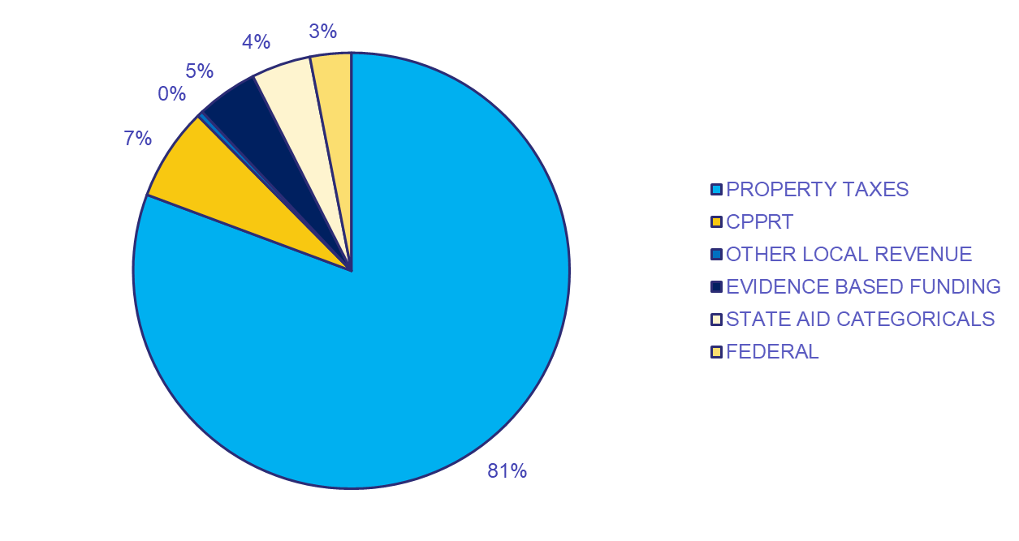
District Revenues

Slide 7
District Revenues-Property Taxes

Slide 8
PTELL Components
Known Variables:
Prior Year Extension (from County)
CPI (from BLS)
Unknown Variables:
EAV (from County Assessor)
New Property (from County Assessor)

Slide 9
How are Property Taxes Calculated under PTELL?
PTELL is a math formula that determines a Limiting Rate:
LR = (Prior Year Extension x (1+ Lessor of 5% or CPI))
(Total EAV – New Property)
LR = ($26,799,624.00 x (1 + 3.4%)
($867,335,502 – $10,000,000)
LR = 3.2322

Slide 10
PTELL Components: Consumer Price Index (CPI)

Slide 11
Levy - “Ask” vs Extension - “Receive”
Levy – Ask
The total ask is for: $28,136,425
Extension – Receive
We expect to receive $28,034,034

Slide 12
Projected Extension - “Actual”
The extension is projected to be $28,034,031
CPI at 3.4%
AV assumption to be down 3%
New Property assumption of $10,000,000
Limiting Rate is 3.2322

Slide 13
Tax Levy Process and Timeline
November 25, 2024
  Vote to approve the 2024 Preliminary Levy
November 25, 2024
  Preliminary levy on display for community
December 16, 2024
  Hold public hearing on tax levy to provide community transparency
  Vote to approve 2024 Final Tax Levy
By December 31, 2024
  File Final Tax Levy with County Clerk

Slide 14
Tax Levy Process and Timeline
January 2025
  County assessor completes assessment of all properties
March 2025
  County clerk sets the levy and divides total dollars among all properties in taxing area
April/May 2025
  Taxpayers receive tax bills

